Slide 1


Intro to Python Language & Data Analytics
Ivan A. Reyes

Slide 2
Python is _________ Programming Language
a High-Level
an Interpreted
a Dynamically-Typed
an Object Oriented

Slide 3
Quite like good old English
Compact Syntax
Blocks are defined by spacing/indentation
Keywords & Syntax imitate regular sentences
Notes:
Seeks good readability. You can get a sense of what a program is supposed to do just by reading the code.
Compact Syntax: List comprehension, Lambda functions,
Block: As opposed to something like curly brackets in say, JS
Keywords & Syntax: if num not in alist

Slide 4
Batteries Included
Built-in Functions
Extensive Standard Library
Wide Community
Packages
Resources
Notes:
Being an open-source language:
-
-
- (Hierarchy of Modules) & (Popularity = Answers/Tutorials/Content)

Slide 5

Anaconda Distribution
Most popular distribution focused on scientific computing with Python
Ships with relevant tools and packages
Provides platform to manage libraries and environments

Slide 6

The Jupyter Notebook
Web-based IDE
Focuses on simple yet extensive visualization
Easily converted to HTML or PDF to share results
Notes:
Documents usually resemble a “scientific” report.

Slide 7
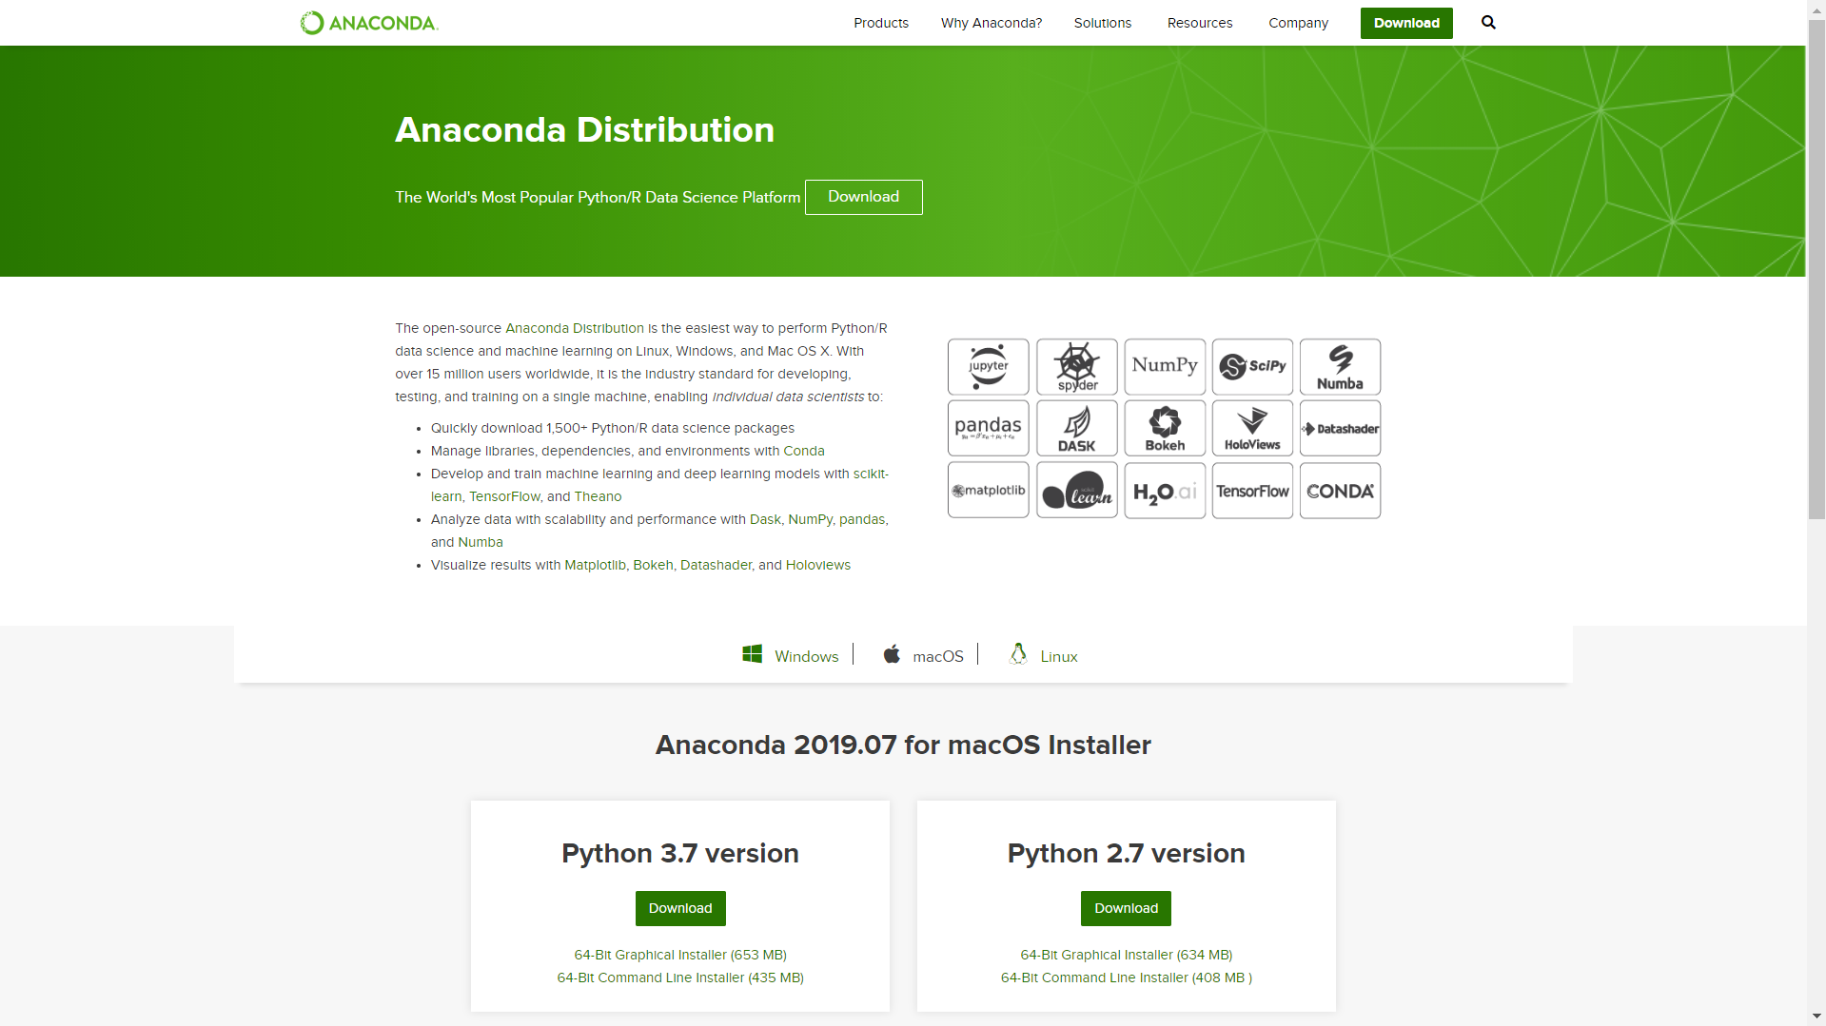
https://www.anaconda.com/distribution/
Select the Graphical Installer & Make sure to select “Add to Path”

Slide 8
Download Intro to Python Notebook YouTube Trending Data Set
http://go.fiu.edu/ShellPy

